Slide 1


Building a Web App for Data Exploration with Smart Mapping
Kristian Ekenes and Jeremy Bartley
Notes:
Esri Corporate Template-Dark v3.3
16:9 version – January 21, 2016
For more templates, sample files, and icons, see https://compass.esri.com/resources/presentations/Pages/Main.aspx
To add footer text in Windows
On the Home tab, under Insert, click Text, and then click Header and Footer.
Click the Slide tab, select the Footer check box, and then type the footer text that you want.
Click either Apply or Apply to All.
To add footer text on a Mac
On the View menu, select Header and Footer.
Select the Footer check box and then type the footer text that you want.
Click either Apply or Apply to All.
If footers don't appear on the slides
If footers don't appear on title slides, in the Header and Footer dialog box make sure the Don't show on title slide check box is not selected.
If the footers are missing from other slides, the placeholders for these items might have been removed from specific slide layouts or the slide master.

Slide 2
Sample App
Mexico Demographics

Slide 3

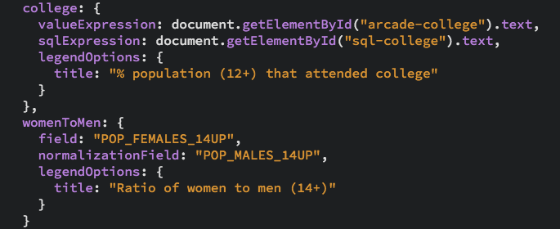


Slide 4
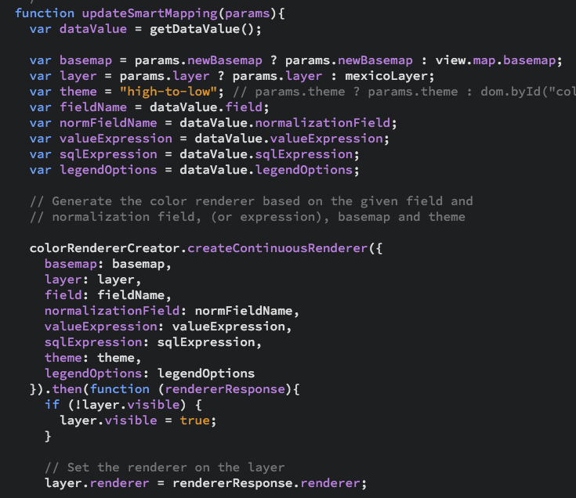

Slide 5
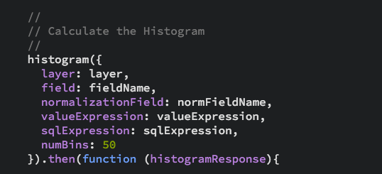

Slide 6
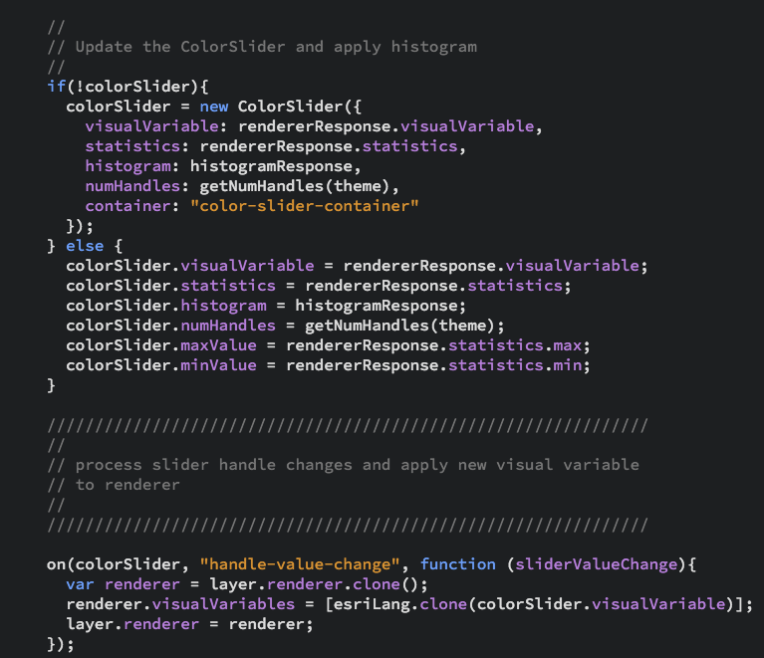
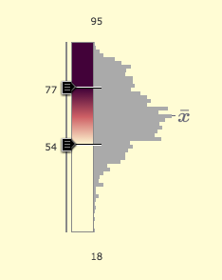

Slide 7
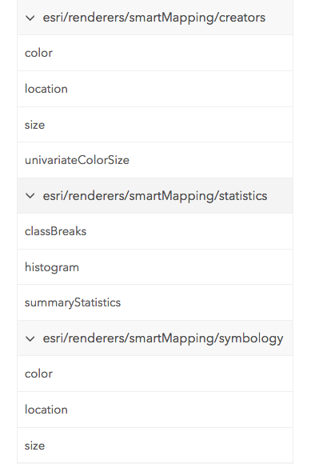
Resources
Documentation
https://developers.arcgis.com/javascript/jsapi/esri.renderers.smartmapping-amd.html
https://developers.arcgis.com/javascript/jsapi/featurelayerstatistics-amd.html
https://developers.arcgis.com/javascript/jsapi/colorinfoslider-amd.html
https://developers.arcgis.com/javascript/jsapi/sizeinfoslider-amd.html
Demos/samples
https://github.com/ekenes/conferences/tree/master/ds-2017/smart-mapping
https://github.com/ekenes/esri-js-samples/tree/master/smart-mapping

Slide 8
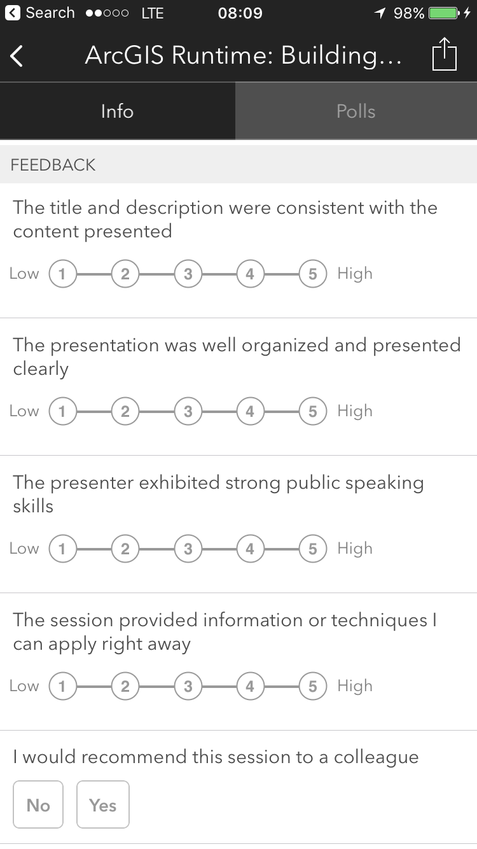
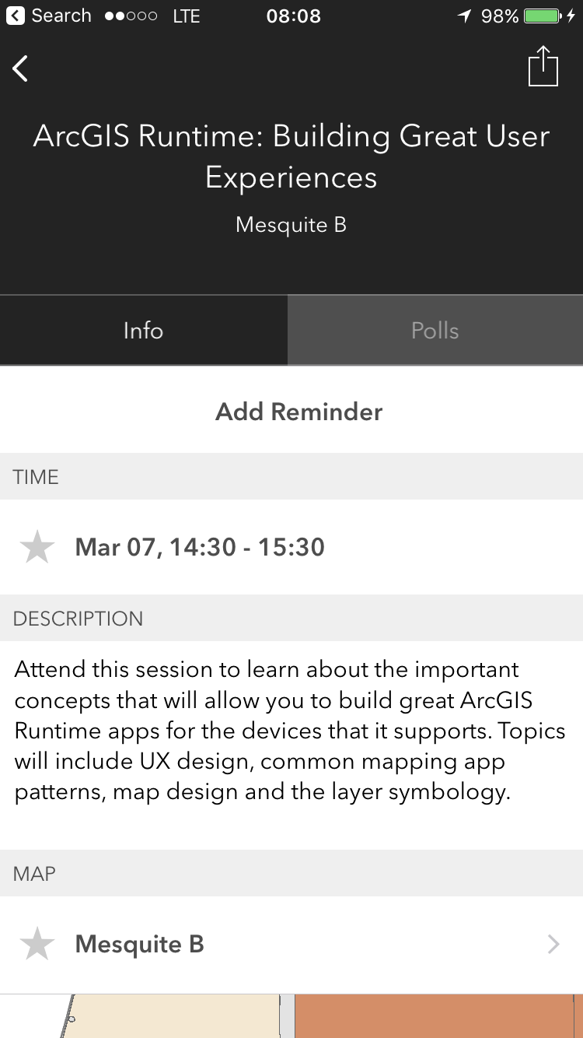

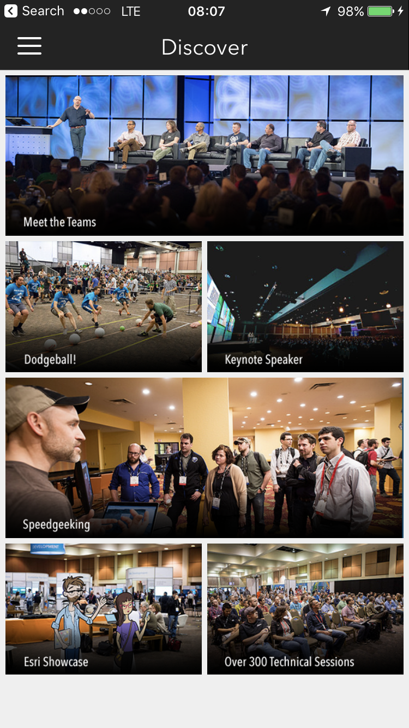
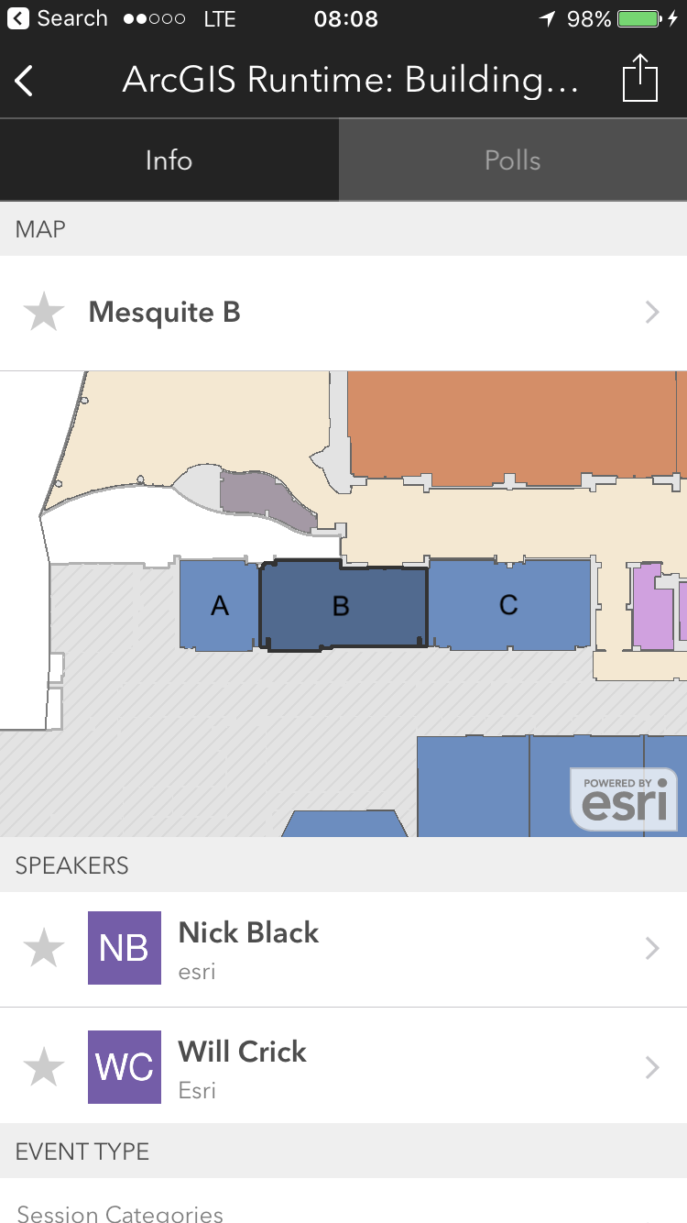
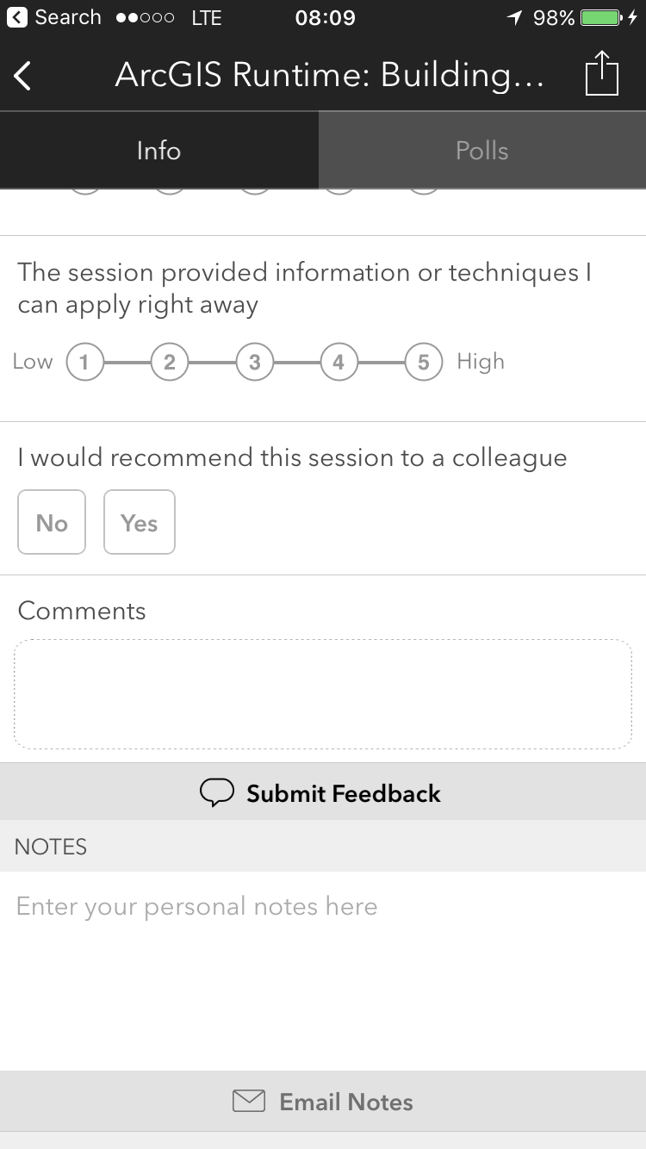
Please Take Our Survey!
Scroll down to the
“Feedback” section
Download the Esri Events app
and go to DevSummit
Select the session you attended
Complete Answers,
add a Comment,
and Select “Submit”

